Slide 1

The QR Code Generator

Slide 2
QR Code Generator
Overview
Objective: Providing smartphone users with information, quickly and simply, is what makes QR Codes and mobile marketing go hand in hand like PB & J. They enhance your marketing campaigns, allowing you to reach, engage and convert a wider target audience by linking from offline to online platforms.
Project: A QR Code maker is a software online that generates or creates your QR Code wherein you can store a variety of data/information in your code. For example, a URL that will land you to a video page, a text, an image, or a website when your QR Code is scanned. QR Codes do not require a heavyset machine scanner to scan them because they are quickly accessible through the camera of a mobile phone or any QR Code reader app. You can scan a QR Code by opening your smartphone camera feature or downloading a QR Code reader. Hold your smartphone steady for 2–4 seconds towards the QR Code you want to scan and click on the notification to access the content of the QR Code.

Slide 3
Features
Generate Dynamic QR Codes.
Track scanning activity.
Track event activity.
Capture contact information of target audience.
Design QR Codes to attract more scans.
Create the type of QR Code you need.
Export vector formats of the QR Code image.
Add error correction to QR Codes.

Slide 4
Benefits
QR codes promote sharing and networking. QR codes are far more than just digital barcodes.
They can be used as a 'call-to-action’.
They can enhance your SMO and SEO.
You can really get creative.
You can measure their effectiveness.
They connect your online and offline media.
Customers love them.

Slide 5
QR Code Generate Easy Steps
There are many QR code generators to choose from. Here's a step-by-step guide using a website called QR Code Generator.
1. Using any web browser, go to the QR Code Generator website.
2. Enter the URL of the website you want the QR code to send people to. Alternatively, you can also enter text or upload a file (perhaps to a flyer you designed or to a restaurant menu).
3.Then create a your QR Code Generator.
4.Scan your QR Code and decrypt the File , Text , Paragraph , Image etc.

Slide 6
QR Code Generate in Three Easy Steps
Step 1: Enter Your Text , Image , Paragraph , Link etc.
Step 2:Click on QR Code Generator button.
Step 3: Generate your QR Code .

Slide 7
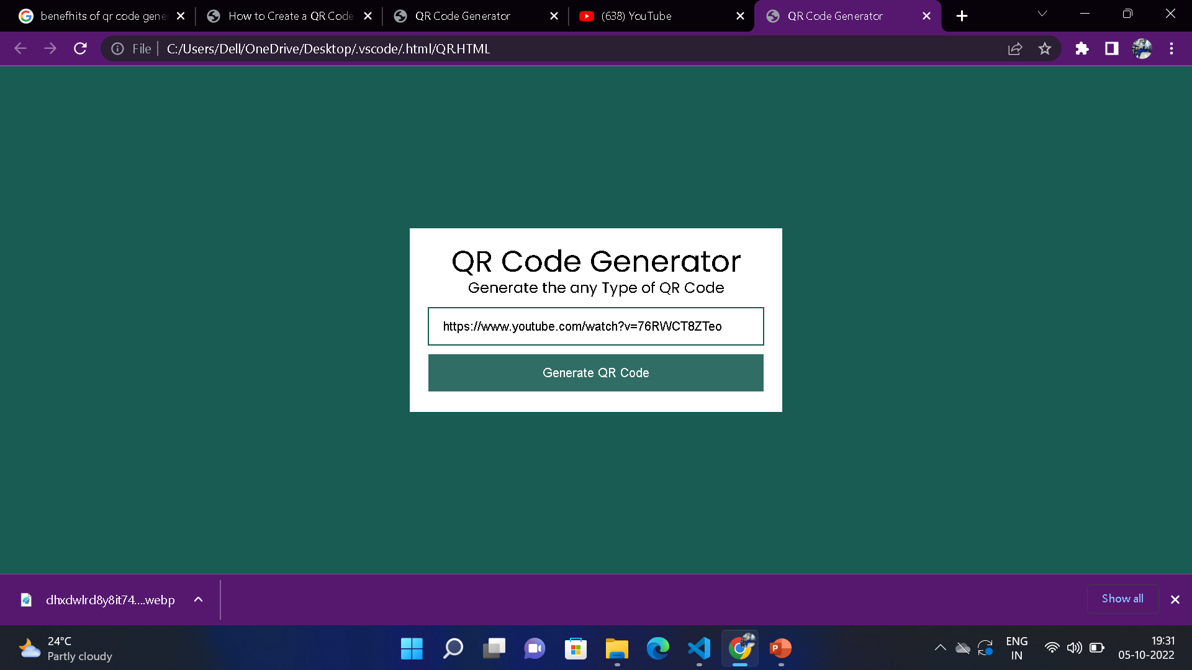
Generate QR Code
Step 1
Enter your data:
  Text.
  Paragraph.
  Image Link.
  Website Link etc.

Slide 8
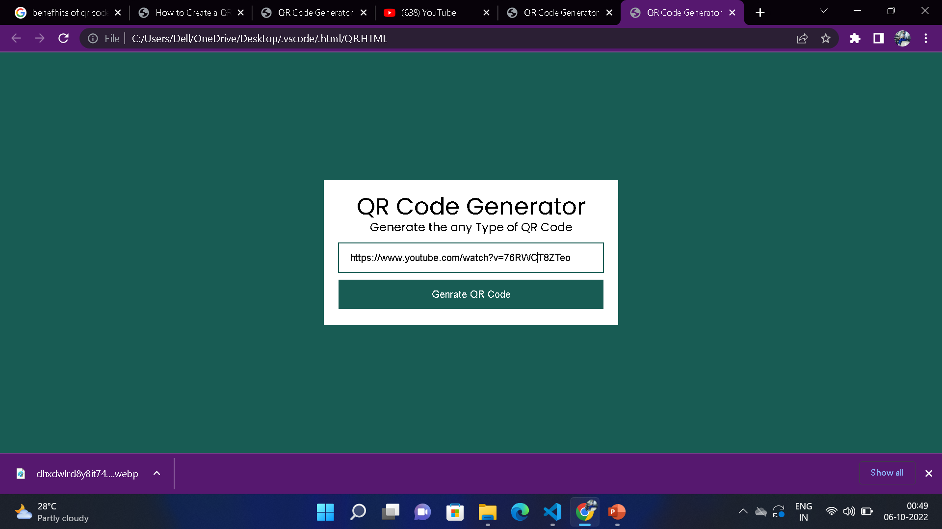
Generate QR Code
Step 2
Click on the QR Code Generator.

Slide 9
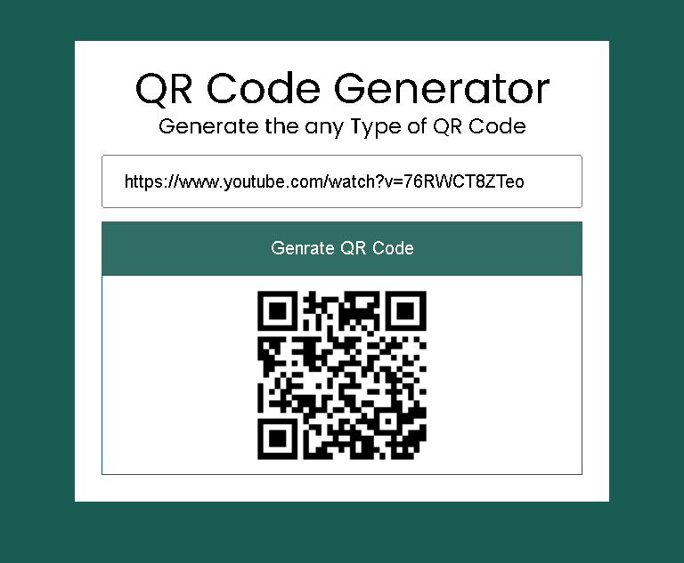
Generate QR Code
Step 3
When we are click on the QR Code Generator button ,Then create a our QR Code for related data.

Slide 10
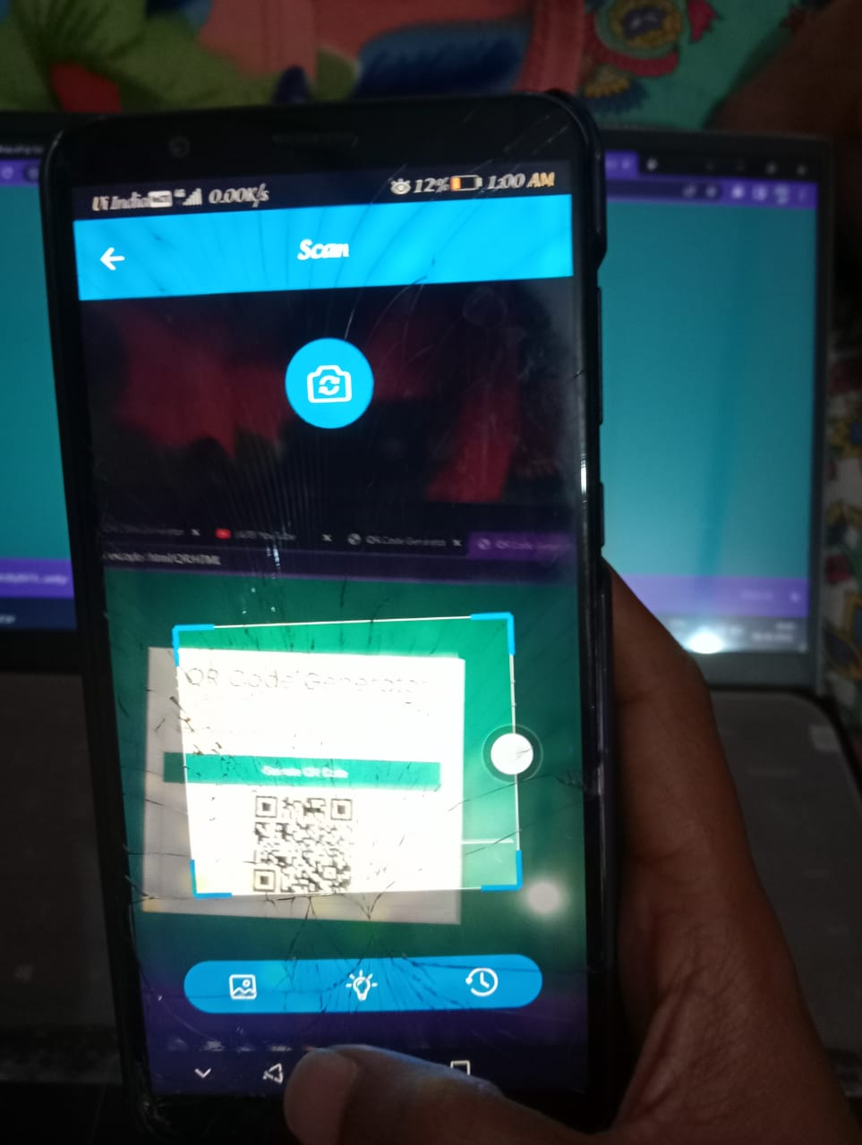
Generate QR Code
Final
Scan the Generate QR Code.

Slide 11
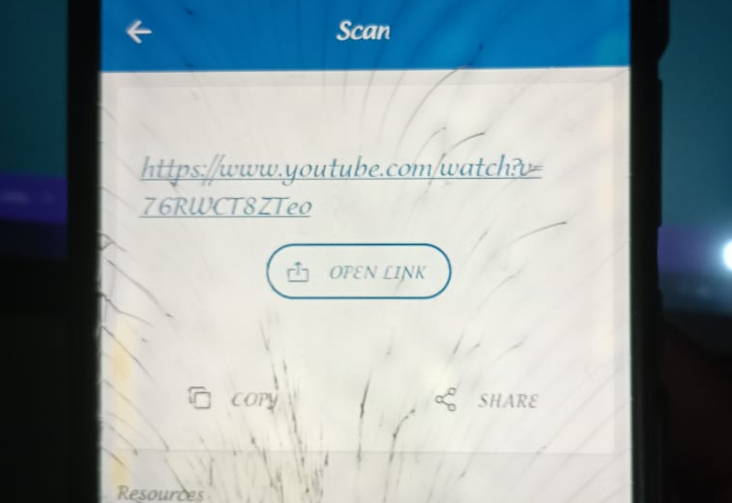
Final
Generate QR Code
Decrypt our data.
Open the link.

Slide 12
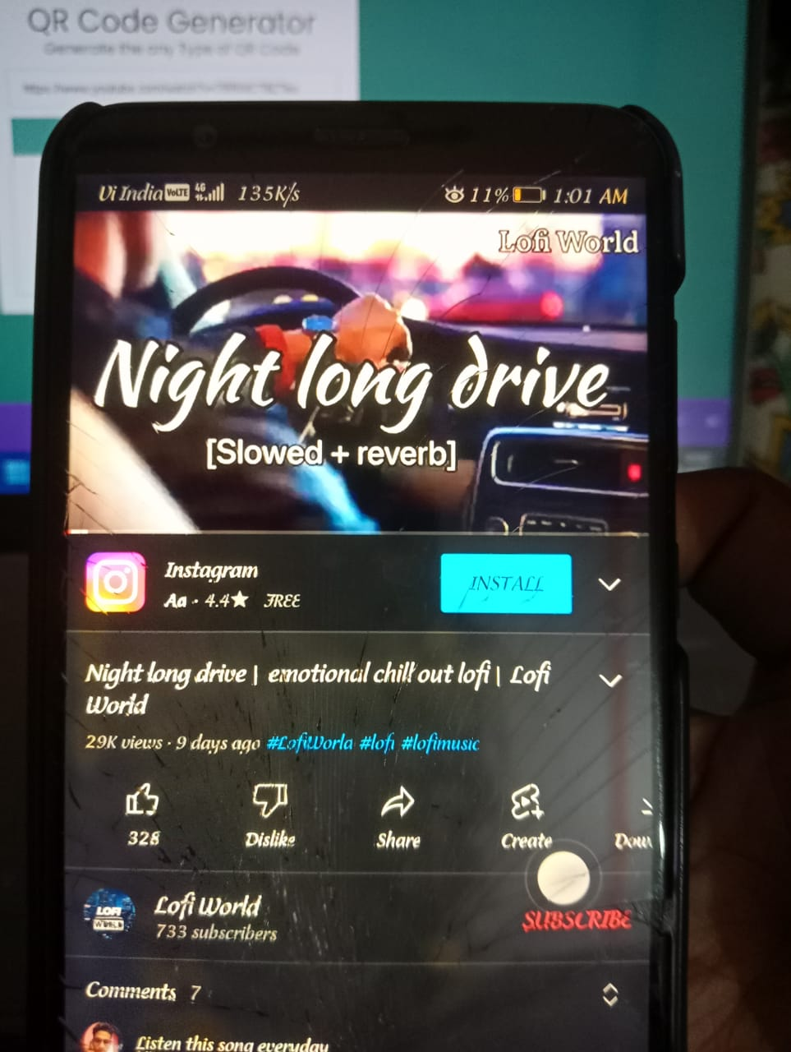
Generate QR Code
Final
open link.

Slide 13
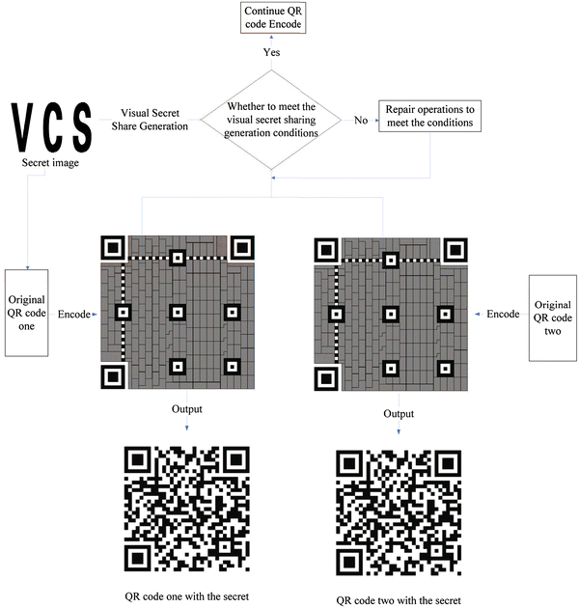
Architecture

Slide 14
Pros and Cons of QR Code Generator
Advantages:
Benefits or advantages of QR code
Following are the benefits or advantages of QR code:
1.The code can be decoded at high speed from any direction.
2.It does not require any light to be generated or to be received from the QR code as done during Barcode scanning.
3.QR-codes are designed for various needs such as URL or web address, phone number, contact information, geo-location with map, text etc. Hence it is used for multi-purposes.
4.Due to error correction part, QR codes can be read easily even after some part is not properly read by the scanning device.
5.It can be scanned anytime, anywhere using mobile phones.
6.No license needed to create or use QR codes.

Slide 15
Disadvantages:
1.Lack of familiarity with the QR code among people.
2.It requires a phone with a camera which makes it costly for the common users to afford.
3.Codes dependability on a smartphone. However, Users must be equipped with a camera’s phone and the correct reader software that can scan the image of the QR codes. However, Currently, the only smartphone is technically equipped to do this.
4.Smartphones used to scan QR codes are often expensive and costly in comparison with simpler phones.
5.Many users that have mobile phones, do not have smartphones, that have cameras that are unable to get QR reading software for their phones.
6.The user is not too familiar with this technology.

Slide 16
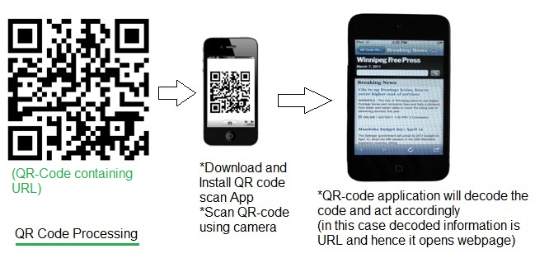
Work of QR Code Generator

Slide 17
Frequently Asked Q&A
Q .no.1. What is aQR Code?
Answer: A QR code is an acronym for Quick Response code. The feature is similar to well-known bar codes, but it can contain much more information. To be precise, a QR code can contain up to 7,089 numerals or 4,296 alphanumeric characters.
Q .no.2.Where can I use QR Code?
Answer: As a consumer, you can use QR codes whenever you get the opportunity to do so. As a business, you can utilize QR codes for a wide range of purposes to make the consumer journey more pleasant and comfortable.
Q .no.3.How are QR Code made?
Answer: There are many online generators that can quickly create a new QR code. New code should contain product-related information as well as the branding details of a given company such as logos, color schemes, etc.

Slide 18
Frequently Asked Q&A
Q .no.4.How can QR Codes help my business grow?
Answer: As bridges between the online and offline world, QR Codes can help you connect with your audiences by providing more information about what your company stands for, where you source materials for products, or the many services you can provide.
Q .no.5.How do I generate QR Code Generator?
Answer: Once you already have an idea of the kind of information you want to share with your target audience, go to QR Code Generator and select the appropriate type of Code, input the necessary information, and design your QR Code to fit your brand image or your own personal taste.
Q .no.6. Can I create my own QR Code?
Answer: As all it takes to design a QR code is a digital tool, you can create your own product very quickly. If you are interested in giving it a try, we recommend you to test the QR Code Generator.

Slide 19
Frequently Asked Q&A
Q .no.7. How are QR Code structured?
Answer: Although simple to create, QR codes have a complex structure that can include a wide range of relevant details about products or services. It contains information about versions and formats, data and error correction keys, timing and position patterns, as well as the quiet zone.
Q .no.8. What is QR Code marketing?
Answer: QR codes can be used for marketing purposes, too. A business can utilize this form of technology to reach out to consumers through their smartphones. That way, marketers can promote products, coupons, one-time deals, and many other offers.

